Slide 1
C Programming
Recursion

Slide 2
What is Recursion?
Recursion is the act of calling a function a second time before the first call of that function has completed.

Slide 3
Very Simple Bad Example
int main(void)
{
callThis();
return 0;
}
void callThis(void)
{
callThis();
}

Slide 4
Another Simple Bad Example
int main(void)
{
callThis();
return 0;
}
void callThis(void)
{
callAnother();
}
void callAnother(void)
{
callThis();
}

Slide 5
Why Are The Examples Bad?
These examples will never terminate naturally.
They'll just run until they overflow the stack.
A crash is the usual behaviour.

Slide 6
What Did The Examples Need?
To be useful, a recursion must have a termination condition that, when true, will stop the recursion.

Slide 7
Very Simple Better Example
int main (void)
{
printf ("printing 5 stars\n");
stars (5);
return 0;
}
void stars (int n)
{
printf ("*");
if (n > 1)
stars (n - 1);
}
When the program runs, stars() is first called, passing 5.
Within stars(), stars() is called again, this time passing 4.
Then 3 ...
Then 2 ...
Then 1 ...
Once stars(1) is called, n is no longer greater than 1 so the recursive call doesn't happen.
The call stack is then "unwound".

Slide 8
"Unwinding" the Call Stack
Unwinding the call stack refers to returning repeatedly from functions that are called until:
there are no more functions on the call stack or
the unwinding is deliberately stopped by executing some other code

Slide 9
Reminder: The "call stack" is the list of functions that you have called to get to where you currently are.

Slide 10
Isn't This Like A Loop?
Recursion is like a loop.
Usually looping should be used instead of recursion.

Slide 11
There are certain situations where recursion works better than looping (taken about next semester).

Slide 12
Two Uses for Recursion
1) Displaying the contents of a directory structure.
2) Binary search.

Slide 13
Simple Binary Search Example
Play a guessing game!
Choose a number between 0 and 1000 and see how long it takes the program to guess it ...

Slide 14
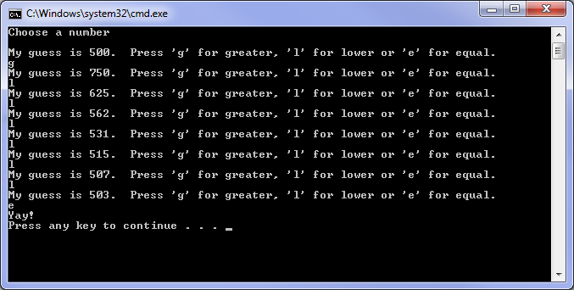

Slide 15
else if( ans == 'g' )
lower = my_guess;
else if( ans == 'l' )
upper = my_guess;
if( lower == upper )
printf("You're cheating.\n");
else
guess (lower, upper, (lower + upper)/2); // call recursively
}
int main(void)
{
printf(“Choose a number\n”);
guess(0, 1000, 500);
}
#include <stdio.h>
#include <conio.h>
void guess(int lower, int upper, int my_guess)
{
char ans = 0;
printf("\nMy guess is %d. Press 'g' for greater, 'l' for lower or 'e' for equal.\n", my_guess);
ans = _getche();
if( ans == 'e' )
{
printf("\nYay!\n");
return;
}

Slide 16
// ...
int main(void)
{
printf(“Choose a number\n”);
guess(0, 1000, 500);
}

Slide 17
void guess(int lower, int upper, int my_guess)
{
char ans = 0;
printf("\nMy guess is %d. Press 'g' for greater, 'l' for lower or 'e' for equal.\n", my_guess);
// ...

Slide 18
// ...
ans = _getche();
if( ans == 'e' )
{
printf("\nYay!\n");
return;
}
// ...

Slide 19
// ...
else if( ans == 'g' )
lower = my_guess;
else if( ans == 'l' )
upper = my_guess;
if( lower == upper )
printf("You're cheating.\n");
else
guess (lower, upper, (lower + upper)/2);

Slide 20
Final Exam Note
You will not be required to write any recursive code on the final exam.

Slide 21
Exercise #1
Set up a project with the stars program.
Set a breakpoint on the if statement in stars().
Go (using F5) until the breakpoint.
Display the call stack (Alt-7).
Go multiple times, until the call stack has the stars(1) call in it. Note that the call stack is accumulating the items.
Step (F10) until the program ends. Note how the call stack unwinds.

Slide 22
Exercise #2
Set up a project with the binary search example.
Try it a few times.
Write your own version that uses a loop instead of recursion.

